Slide 1

SMART GPS TRACKER SYSTEM USING ARDUINO
Department of CSE
(ARTIFICIAL INTELLIGENCE AND MACHINE LEARNING)
ESD MINI PROJECT
Presented By:
RAHUL V(ENG22AM0189)
POOJITHA R (ENG22AM0160)
CHETANAANANDA R (ENG22AM0188)
HARISHIV R(ENG22AM0151)
ARUNISH AS(ENG22AM0148)
​

Slide 2
INTRODUCTION
- Project Aim: Develop a smart GPS tracker using Arduino.
- Functionality: Provides real-time location tracking.
- Applications: Personal safety, fleet management, wildlife monitoring, asset security.
- Arduino Benefits: Customizable, cost-effective, efficient.
Significance
- Enhances Safety: Real-time tracking for children, elderly, adventurers.
- Improves Efficiency: Optimizes route planning, reduces fuel consumption.
- Supports Wildlife Research: Non-intrusive animal tracking.
- Secures Assets: Monitors valuable equipment, prevents theft.
What is a GPS Tracker?
- Definition: Device using GPS to determine and record location.
- Function: Communicates with satellites for positioning.
- Features: Real-time data transmission, geofencing, GSM/LTE integration

Slide 3
APPLICATIONS
1. Personal Safety and Security:
- Child and Elderly Tracking: Ensures safety with real-time data.
- Personal Security Devices*: Sends location during emergencies.
2. Fleet Management and Logistics
- Vehicle Tracking*: Enhances route planning, efficiency.
- Asset Tracking*: Monitors equipment, cargo.
3. Wildlife and Environmental Monitoring:
- Animal Tracking*: Studies behavior, migration.
- Environmental Monitoring*: Supports research, conservation.
4. Sports and Recreation:
- Adventure Sports: Tracks routes, performance.
- Fitness Tracking: Monitors activities like running, cycling.
5. Emergency Response and Disaster Management:
- Search and Rescue: Improves response times.
- Disaster Management: Coordinates relief efforts with location data.

Slide 4
OBJECTIVE
Real-time tracking: Implement a reliable GPS tracking solution that provides accurate real-time location data of assets, vehicles, or individuals.
Cost-effectiveness: Design a solution that is affordable and accessible, leveraging Arduino's open-source hardware and software to keep costs low without compromising on functionality.
Ease of use: Create a user-friendly interface for configuring, monitoring, and retrieving location data, ensuring that users with varying technical expertise can easily operate the system.
Customizability: Allow for flexibility in system configuration and integration with other devices or platforms, enabling users to tailor the system to their specific tracking needs and preferences.
Reliability and durability: Build a robust hardware and software solution capable of withstanding various environmental conditions and providing consistent performance over time.
Overall, the Smart GPS Tracker System aims to provide an affordable, user-friendly, and customizable tracking solution that enables individuals and businesses to monitor the location of their assets effectively, leading to improved security, efficiency, and peace of mind.

Slide 5
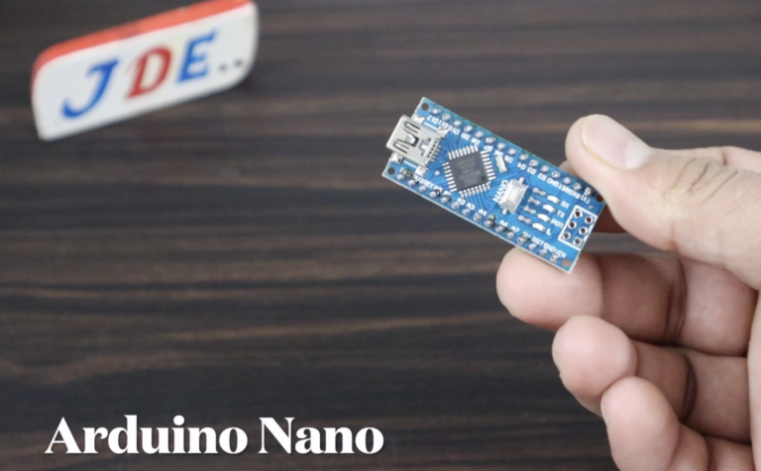
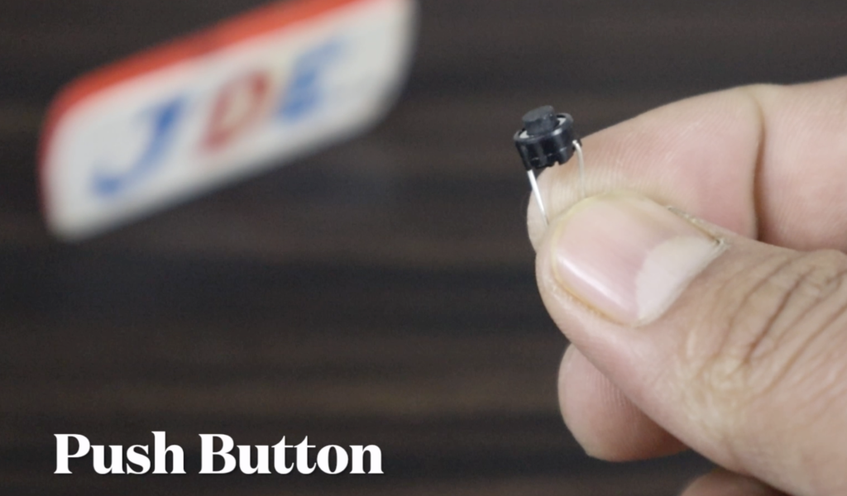
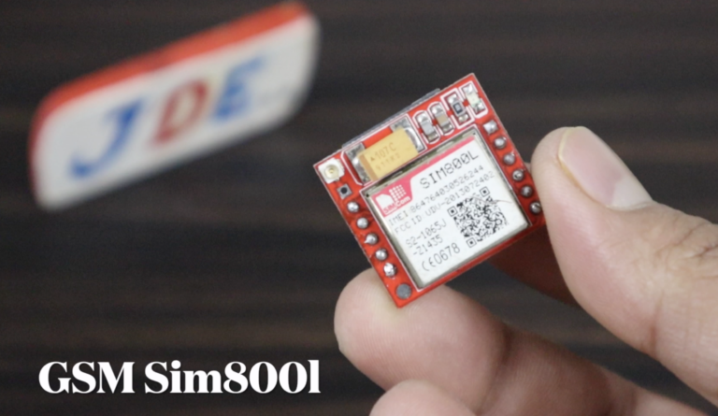
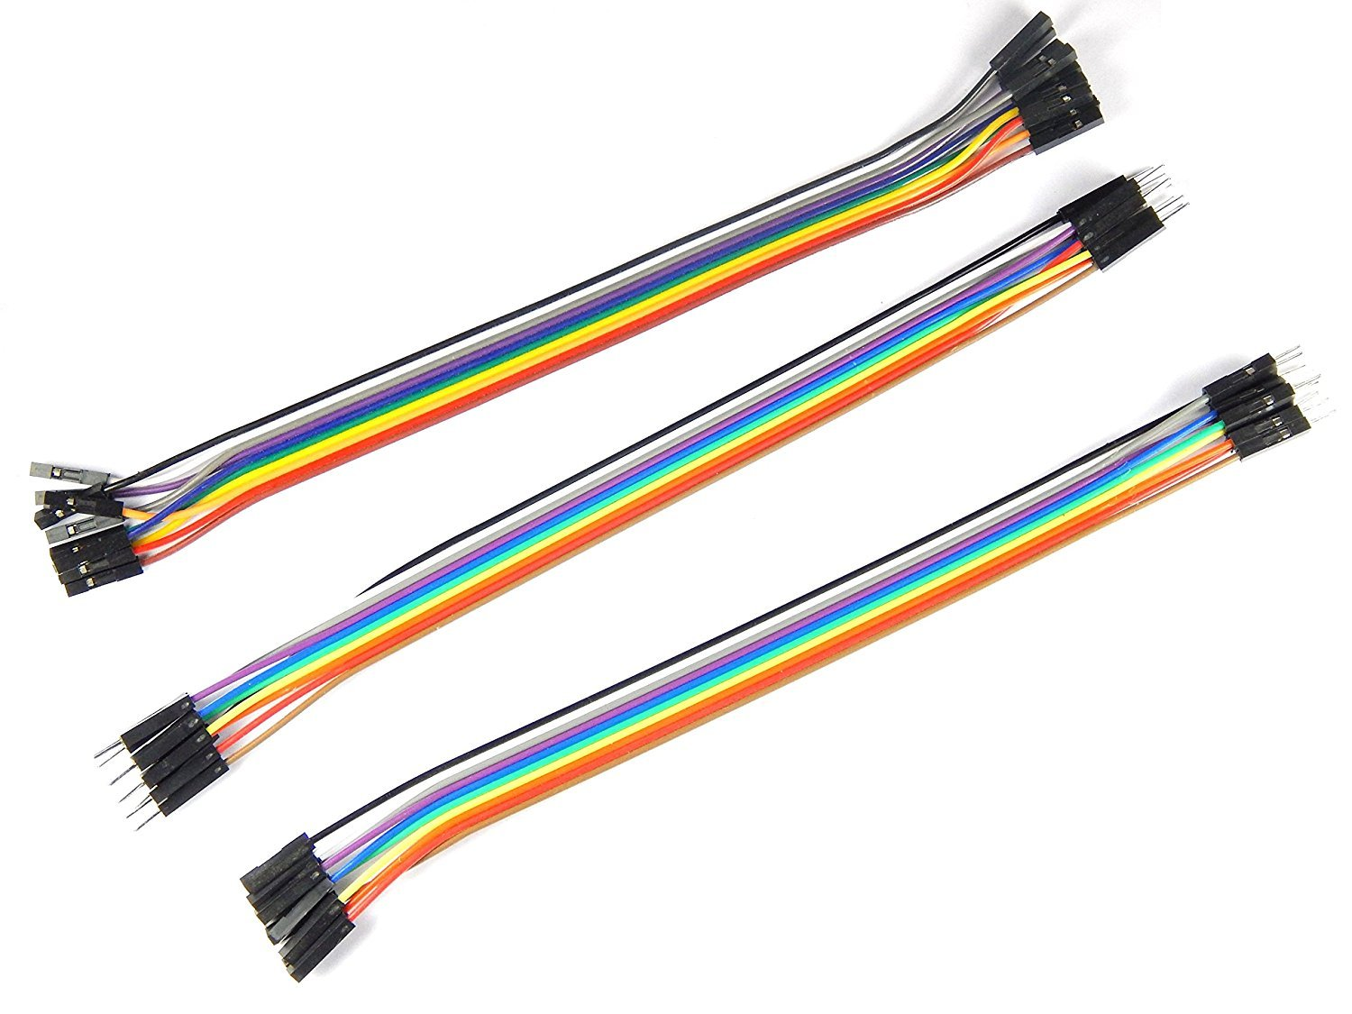
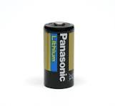
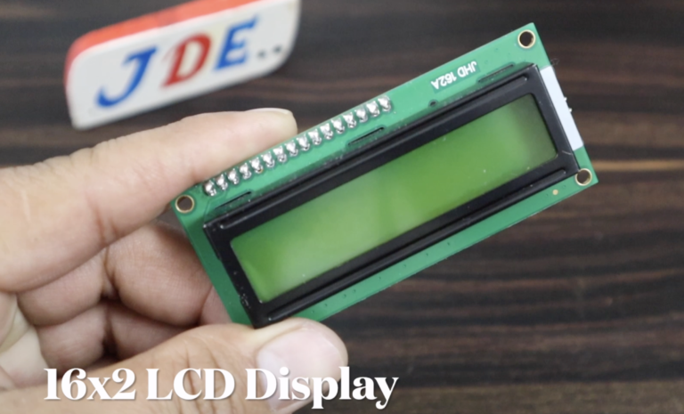
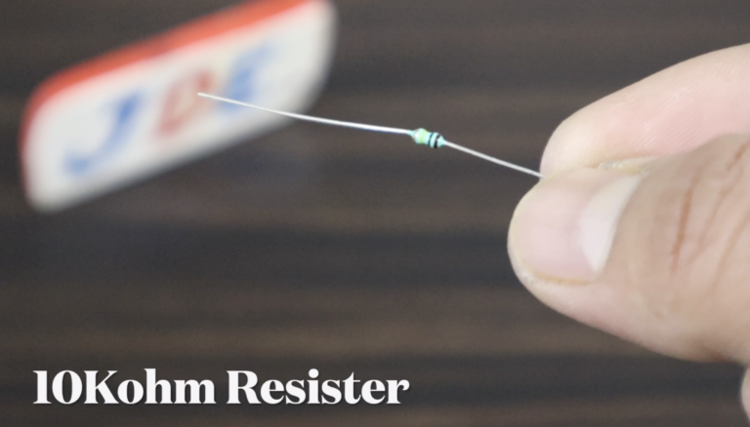
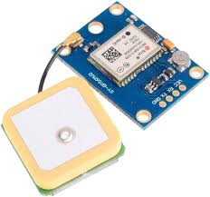
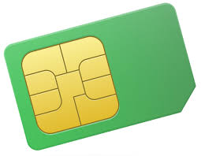
COMPONENTS REQUIRED:
-GPS Module
-Arduino Nano
-SIM800L
-2G SIM card
-OLED Display
-Small 3V battery
-Wires

Slide 6
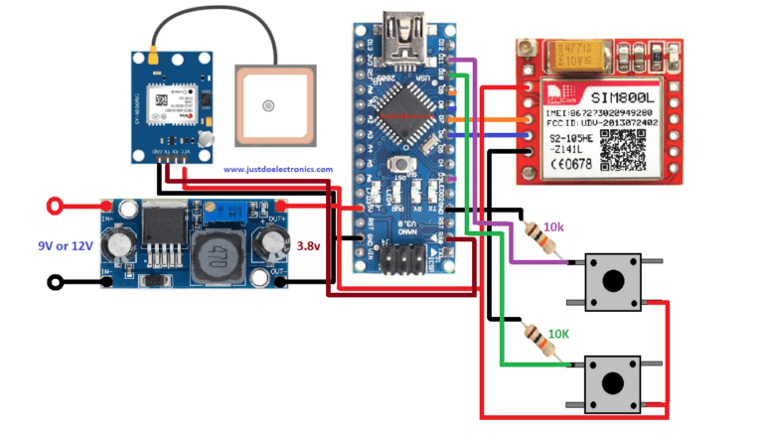
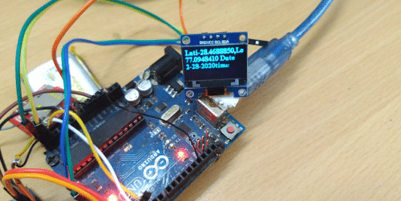
CIRCUIT DIAGRAM

Slide 7
CODE
#include <Adafruit_FONA.h>
#include <TinyGPS++.h>
#include <SoftwareSerial.h>
// Constants and object initialization
static const uint32_t GPSBaud = 9600;
TinyGPSPlus gps;
#define FONA_RX 4
#define FONA_TX 5
#define FONA_RST 11
char replybuffer[255];
char message[141];
String commands = "";
String YourArduinoData = "";
SoftwareSerial fonaSS = SoftwareSerial(FONA_TX, FONA_RX);
SoftwareSerial *fonaSerial = &fonaSS;
Adafruit_FONA fona = Adafruit_FONA(FONA_RST);
/ Function prototypes
uint8_t readline(char *buff, uint8_t maxbuff, uint8_t timeout = 0);
void getloc();
void displayInfo();
void setup() {
Serial.begin(GPSBaud);
Serial.println(F("FONA SMS caller ID test"));
Serial.println(F("Initializing....(May take 3 seconds)"));
pinMode(13, OUTPUT);
fonaSerial->begin(4800);
if (!fona.begin(*fonaSerial)) {
Serial.println(F("Couldn't find FONA"));
while (1);
}
Serial.println(F("FONA is OK"));

Slide 8
// Print SIM card IMEI number
char imei[16] = {0}; // MUST use a 16 character buffer for IMEI!
uint8_t imeiLen = fona.getIMEI(imei);
if (imeiLen > 0) {
Serial.print("SIM card IMEI: "); Serial.println(imei);
}
fonaSerial->print("AT+CNMI=2,1\r\n"); // Set up the FONA to send a +CMTI notification when an SMS is received
Serial.println("FONA Ready");
}
char fonaNotificationBuffer[64]; // for notifications from the FONA
char smsBuffer[250];
void loop() {
getloc();
char* bufPtr = fonaNotificationBuffer;
if (fona.available()) {
int slot = 0;
int charCount = 0;
// Read the notification into fonaNotificationBuffer
do {
*bufPtr = fona.read();
Serial.write(*bufPtr);
delay(1);
} while ((*bufPtr++ != '\n') && (fona.available()) && (++charCount < (sizeof(fonaNotificationBuffer) - 1)));
*bufPtr = 0;
if (1 == sscanf(fonaNotificationBuffer, "+CMTI: " FONA_PREF_SMS_STORAGE ",%d", &slot)) {
Serial.print("slot: "); Serial.println(slot);
char callerIDbuffer[32]; // we'll store the SMS sender number in here
if (!fona.getSMSSender(slot, callerIDbuffer, 31)) {
Serial.println("Didn't find SMS message in slot!");
}

Slide 9
if (fona.deleteSMS(slot)) {
Serial.println(F("OK!"));
} else {
Serial.println("Deleting SMS from device failed");
Serial.print(F("Couldn't delete SMS in slot ")); Serial.println(slot);
fona.print(F("AT+CMGD=?\r\n"));
}
}
}
}
}
void getloc() {
// This sketch displays information every time a new sentence is correctly encoded.
if (Serial.available() > 0)
if (gps.encode(Serial.read()))
displayInfo();
if (millis() > 5000 && gps.charsProcessed() < 10) {
Serial.println(F("No GPS detected: check wiring."));
while (true);
}
Serial.print(F("FROM: ")); Serial.println(callerIDbuffer);
// Retrieve SMS value.
uint16_t smslen;
if (fona.readSMS(slot, smsBuffer, 250, &smslen)) { // pass in buffer and max len!
Serial.println(smsBuffer);
commands = smsBuffer;
Serial.println(commands);
if (commands == "get loc") {
digitalWrite(13, HIGH);
if (!fona.sendSMS(callerIDbuffer, message)) {
Serial.println(F("Failed"));
} else {
Serial.println(F("Sent!"));
digitalWrite(13, LOW);
}
}

Slide 10
}
void displayInfo() {
Serial.println("Location");
Serial.print(F("_Location---"));
Serial.print(gps.location.lat(), 10);
Serial.print(F(","));
Serial.print(gps.location.lng(), 10);
Serial.print(F("_Date"));
Serial.print(gps.date.month());
Serial.print(F("/"));
Serial.print(gps.date.day());
Serial.print(F("/"));
Serial.print(gps.date.year());
Serial.print(F("--------"));
if (gps.time.hour() < 10) Serial.print(F("0"));
Serial.print(gps.time.hour());
Serial.print(F(":"));
if (gps.time.minute() < 10) Serial.print(F("0"));
Serial.print(gps.time.minute());
Serial.print(F(":"));
if (gps.time.second() < 10) Serial.print(F("0"));
Serial.println();
char latitude[18];
char longitude[18];
dtostrf(gps.location.lat(), 8, 7, latitude);
dtostrf(gps.location.lng(), 8, 7, longitude);
YourArduinoData = ("https://www.google.com/maps/place/" + String(latitude) + "," + String(longitude));
YourArduinoData.toCharArray(message, 141);
}

Slide 11
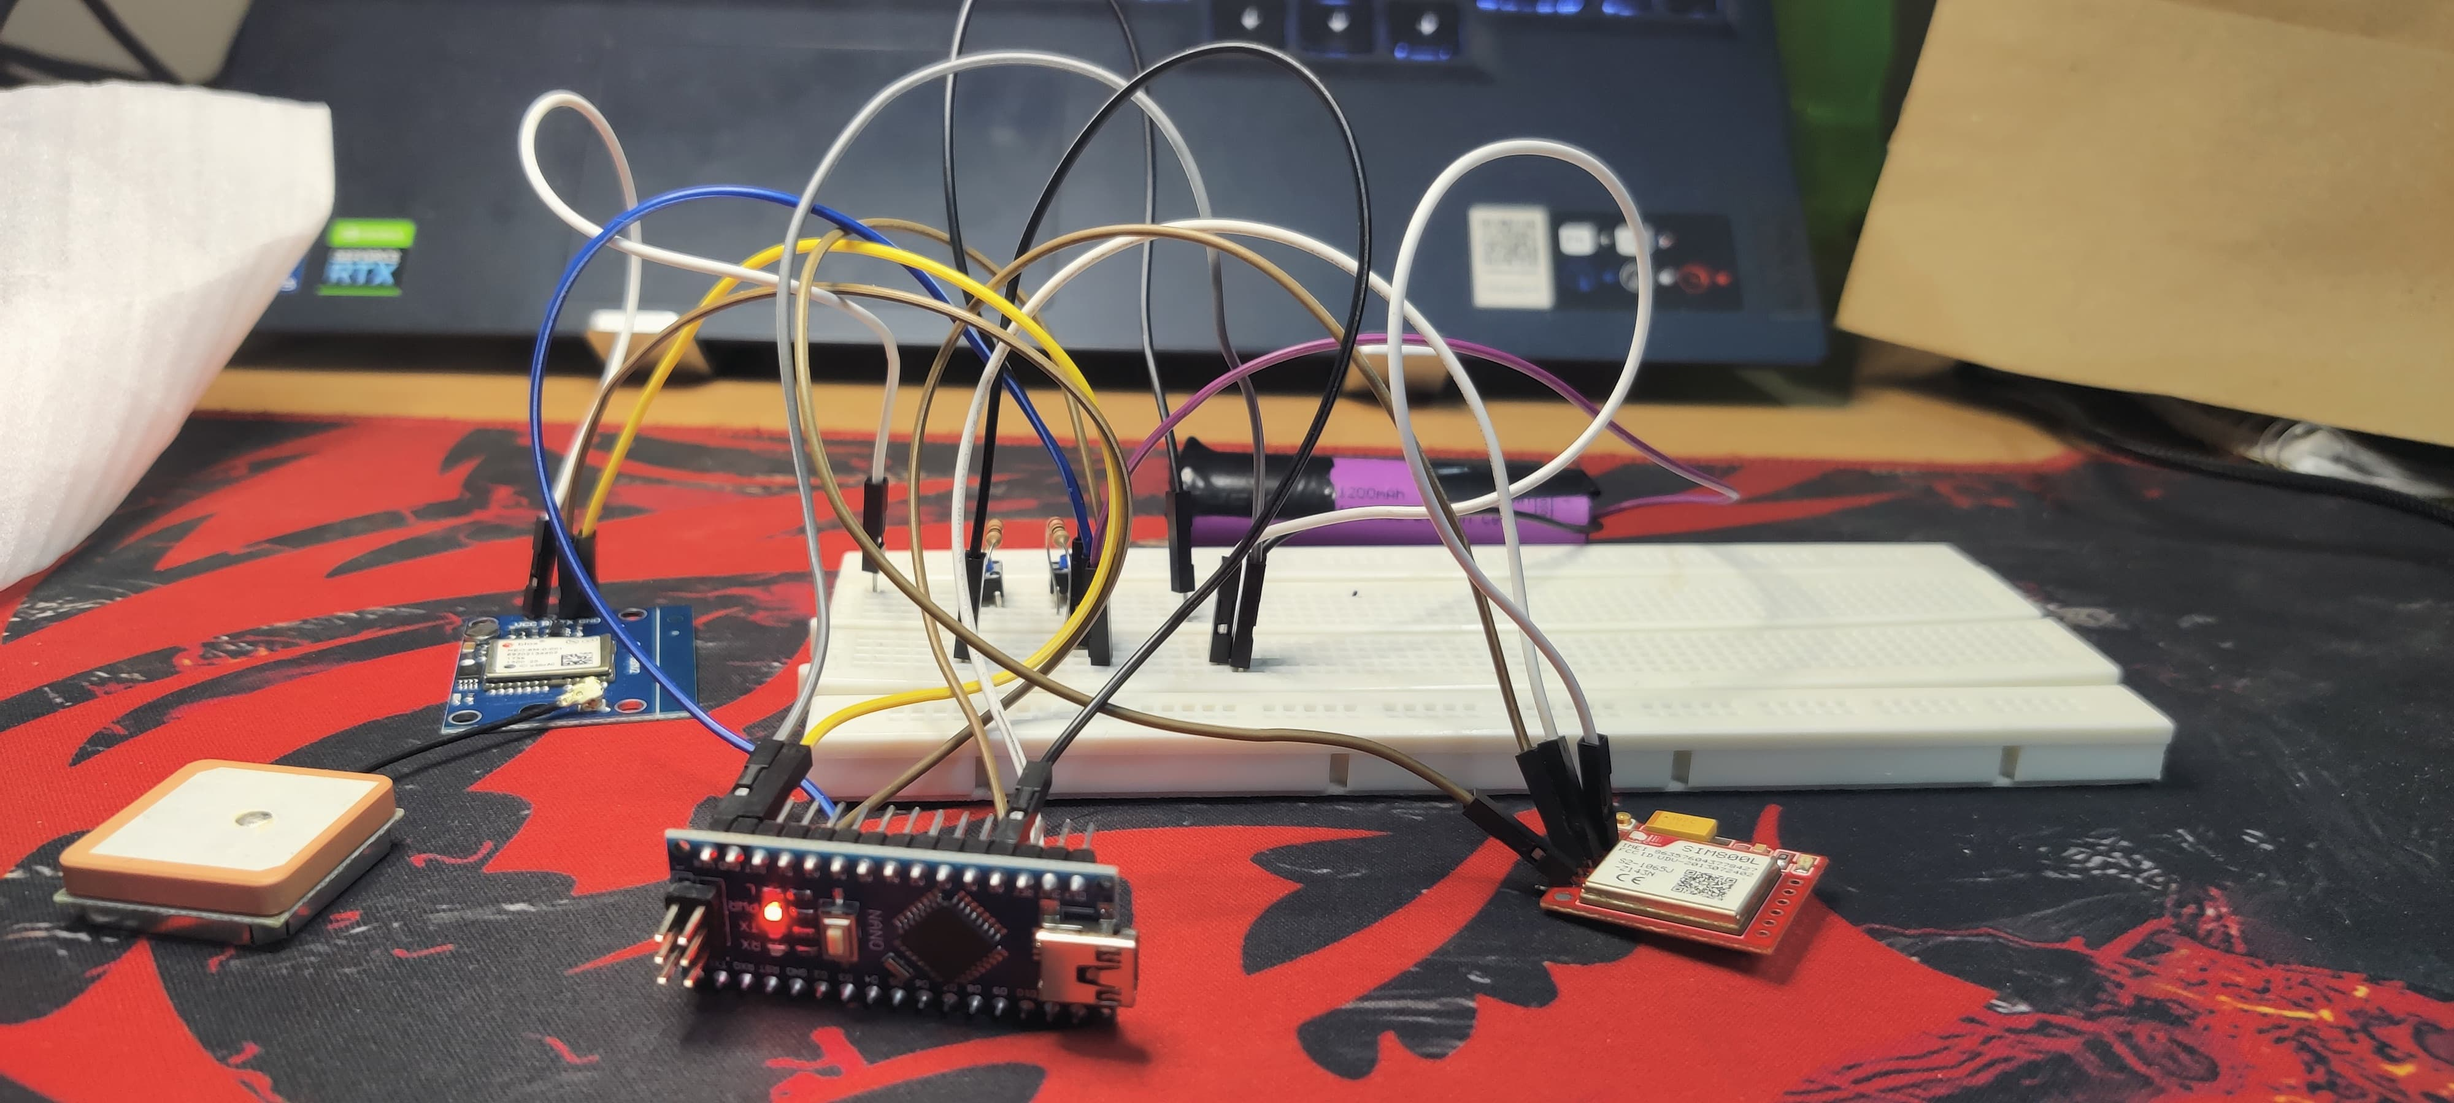
OUR IMPLEMENTATION

Slide 12
Hardware Connections :
GPS Module to Arduino Nano:
-Connect the TX pin of the GPS module to a digital RX pin (e.g., D2) on the Arduino Nano.
-Connect the RX pin of the GPS module to a digital TX pin (e.g., D3) on the Arduino Nano.
-Connect the VCC pin of the GPS module to the 3.3V output pin on the Arduino Nano.
-Connect the GND pin of the GPS module to any GND pin on the Arduino Nano.
SIM800L to Arduino Nano:
-Connect the TX pin of the SIM800L to a digital RX pin (e.g., D4) on the Arduino Nano.
-Connect the RX pin of the SIM800L to a digital TX pin (e.g., D5) on the Arduino Nano.
-Connect the VCC pin of the SIM800L to the 5V output pin on the Arduino Nano.
-Connect the GND pin of the SIM800L to any GND pin on the Arduino Nano.
OLED Display to Arduino Nano:
-Connect the SDA pin of the OLED display to the A4 pin (SDA) on the Arduino Nano.
-Connect the SCL pin of the OLED display to the A5 pin (SCL) on the Arduino Nano.
-Connect the VCC pin of the OLED display to the 5V output pin on the Arduino Nano.
-Connect the GND pin of the OLED display to any GND pin on the Arduino Nano.

Slide 13
Battery :
-Connect the positive terminal of the 3V battery to the VIN pin on the Arduino Nano.
-Connect the negative terminal of the battery to any GND pin on the Arduino Nano.
Software Setup:
-Install the necessary libraries for the GPS module, SIM800L, and OLED display in the Arduino IDE.
-Write the Arduino sketch to initialize and communicate with the GPS module, SIM800L, and OLED display.
Communicating with GPS Module and SIM800L:
-Configure the Arduino serial ports to communicate with the GPS module and SIM800L.
-Read GPS data from the GPS module and send it to the SIM800L for transmission to a server or user via SMS or GPRS.
Displaying Information on OLED Display:
-Display relevant information such as GPS coordinates, time, date, and status messages on the OLED display.
Power Supply:
-Ensure that the Arduino Nano and components are powered by the 3V battery or an external power source as per the requirements.

Slide 14
Testing Process:
1. Hardware Setup:
- Connect all the components according to the provided wiring instructions.
- Double-check connections to ensure they are secure and correctly made.
- Power up the system and verify that all components are receiving power.
2. Software Configuration:
- Write and upload the Arduino sketch to the Arduino Nano.
- Configure the sketch to initialize communication with the GPS module and SIM800L module.
- Test each component's functionality separately to ensure they work as expected.
3. GPS Module Testing:
- Verify that the GPS module is receiving signals from satellites by checking for a valid fix.
- Read and display the GPS data (latitude, longitude, altitude, etc.) on the Arduino Serial Monitor to confirm accurate reception.
4. SIM800L Module Testing:
- Test the SIM800L module's communication by sending AT commands through the Arduino Serial Monitor.
- Ensure the SIM card is inserted correctly and recognized by the module.
- Verify the ability to send test SMS messages or establish a GPRS connection.

Slide 15
5. OLED Display Testing:
- Display test messages and graphics on the OLED display to ensure it's functioning correctly.
- Integrate the display into the Arduino sketch and verify that it can display relevant information such as GPS coordinates.
6. Integrated System Testing:
- Combine the functionalities of the GPS module, SIM800L module, and OLED display in the Arduino sketch.
- Test the system under various conditions (indoors, outdoors, moving, stationary) to ensure reliable performance.
- Verify that GPS data is accurately transmitted via SMS or GPRS and displayed on the OLED display.

Slide 16
Challenges Faced:
Power Management: Managing power consumption to ensure the system operates efficiently without draining the battery too quickly, especially considering components like the GPS module and SIM800L.
Signal Reception:
-Dealing with potential issues related to GPS signal acquisition, especially indoors or in areas with poor satellite visibility.
-Ensuring stable GSM network connectivity and addressing signal strength fluctuations or coverage gaps.
Software Integration:
-Integrating multiple software modules for GPS tracking, cellular communication, and display output.
-Debugging and resolving compatibility issues or conflicts between libraries used for different components.

Slide 17
Results:
Upon successful testing , the Smart GPS Tracker System should be able to:
-Accurately track the device's location using GPS.
Transmit GPS data via SMS or GPRS using the SIM800L module and the 2G SIM card.
-Display relevant information such as GPS coordinates on the OLED display.
-Provide reliable performance under various conditions, demonstrating its effectiveness as a GPS tracking solution.

